Slide 1
LA Mobility
Default View
Option 1

Slide 2
Common Tasks & Requests:
I want:
A new device or line.
International Roaming activated.
Transfer a line to an employee.
Disconnect a line
Review my personal charges
Report a STOLEN LINE!
Get Help:
I want:
Contact someone to help me.
Status of my request (ticket)
Escalate my request.
HELP with my INVOICE
View my invoice
Tips & Tricks
Policies:
Can I:
Apply for a mobile phone?
Get the global policies?
Get the regional policies?
Get local principles?
Devices & Country Info:
I want:
Info for devices (mobile phones, Aircards, iPhones/iPads, Blackberrys)
Coverage status per country
Other relevant country data

Slide 3
LA Mobility
Default View
Option 2

Slide 4
Common Tasks & Requests:
I want:
A new device or line.
International Roaming activated.
Transfer a line to an employee.
Disconnect a line
Review my personal charges
Report a STOLEN LINE!
Welcome to mobility.PG.com, your starting place for all mobile devices. From here you can access information on a wide variety of mobile devices such as Air Cards, smart phones, cell phones, and pagers
Get Help:
I want:
Contact someone to help me.
Status of my request (ticket)
Escalate my request.
Help with my invoice
Policies:
Can I:
Apply for a mobile phone?
Get the global policies?
Get the regional policies?
Get local principles?
Devices & Country Info:
I want:
Info for devices (mobile phones, Aircards, iPhones/iPads, Blackberrys)
Coverage status per country
Other relevant country data

Slide 5
LA Mobility
Site Navigation

Slide 6
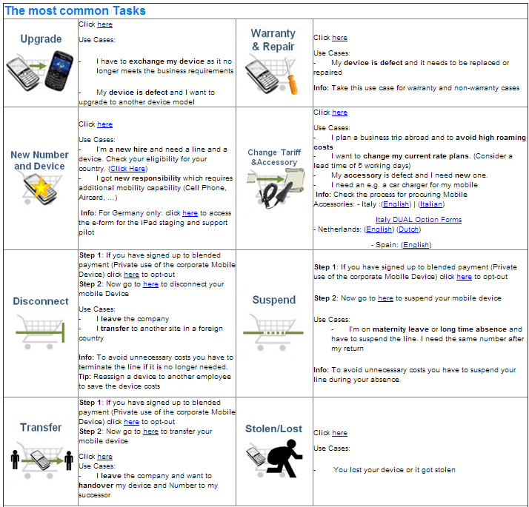
Common Tasks & Requests:
I want:
A new device or line.
International Roaming activated.
Transfer a line to an employee.
Disconnect a line

Slide 7
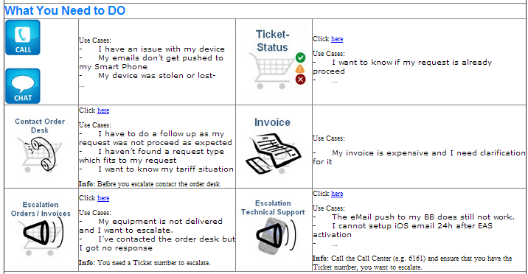
Use Cases:
My invoice is expensive and I need clarification for it.
HELP with my INVOICE
View my invoice
Tips & Tricks
Click here
Get Help:
I want:
Contact someone to help me.
Status of my request (ticket)
Escalate my request.
Help with my invoice

Slide 8
INVOICE:
My invoice is expensive and I need clarification for it.
HELP with my INVOICE
View my invoice
Tips & Tricks
About your invoice
How to view my invoice?
How to read my invoice?
What means all the charges that the carrier is invoicing to me?
Tips & Tricks
How can I setup a WiFi?
Which are the differences between EDGE/3G?
Which are the costs of international roaming?
Another tips & tricks that can help me on my way.

Slide 9
How to view and read your invoice
Click here
Data dictonary about charges
Languages:
Spanish
Languages:
Portuguese
Languages:
Spanish
About your invoice
How to view my invoice?
How to read my invoice?
What means all the charges that the carrier is invoicing to me?
Languages:
Spanish
Languages:
Spanish
Languages:
Spanish
Languages:
Spanish
Languages:
Spanish
Languages:
Spanish
Languages:
Spanish

Slide 10
THINGS NOT TO DO
- HOW TO AVOID SURPRISE CHARGES
Blackberry
How can I setup a WiFi? → Click here
Which are the costs of international roaming? → Click here
Tips & Tricks → Click here
iPad / iPhones
How can I setup a WiFi? → Click here
How can I setup to AgileC0nnect (Only Corporate Devices & BYOM) → Click here
Which are the costs of international roaming? → Click here
Tips & Tricks → Click here
Tips & Tricks
How can I setup a WiFi?
Which are the differences between EDGE/3G?
Which are the costs of international roaming?
Another tips & tricks that can help me on my way.
FAQ
Question | Recommendation
How, When & Where have a call? | 1st Choice – Use Lync/Commuicator 2nd Choice – Use the Office Phone 3rd Choice – Use ICC + Hotel Phone (use ESP Cards) 4th Choice – Corporate Device Download a QuickCard here
How, When & Where read your email? | 1st Choice – Use your laptop with WiFi 2nd Choice – Always Switch On WiFi in your corporate device 3rd Choice – Enable Data Roaming ONLY for quick sync when NO WiFi available Download a QuickCard here
My email isn’t downloading → How to activate an int. Roaming package? | Contact Call Center. For more information click here

Slide 11
Read the Mobility policy to find out for which device you are eligible and what are the usage principles
What you need to know
Global Policy here
Regional Policy here
Local Principles
Languages:
Spanish
Languages:
Portuguese
Languages:
Spanish
Policies:
Can I:
Apply for a mobile phone?
Get the global policies?
Get the regional policies?
Get local principles?
Languages:
Spanish
Languages:
Spanish
Languages:
Spanish
Languages:
Spanish
Languages:
Spanish
Languages:
Spanish
Languages:
Spanish

Slide 12
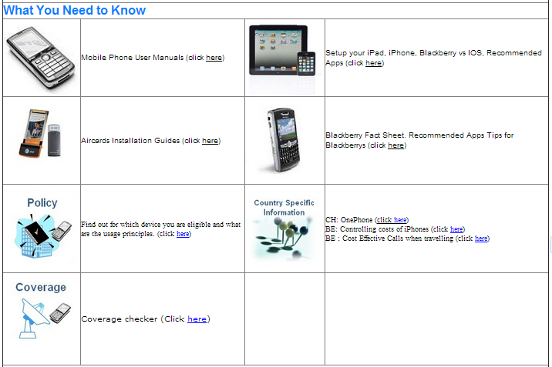
Devices & Country Info:
I want:
Info for devices (mobile phones, Aircards, iPhones/iPads, Blackberrys)
Coverage status per country
Other relevant country data

